Slide 1
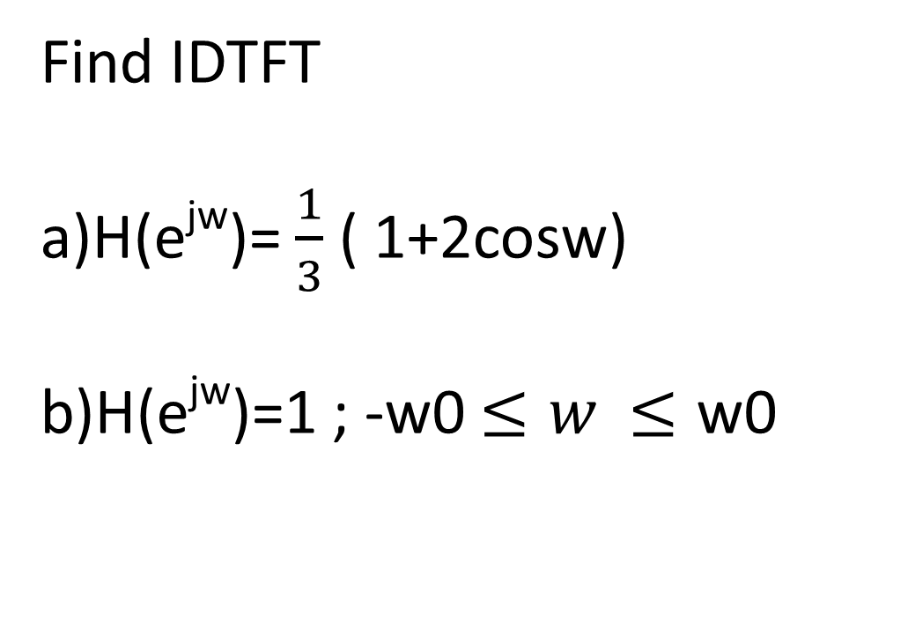
Find IDTFT
H(e^{jw})= $\frac{1}{3}$ ( 1+2cosw)
H(e^{jw})=1 ; -w0 $≤w$ $≤\text{w}\text{0}$

Slide 2


Slide 3
Which is more important for a given signal?
Does one component (magnitude or phase) contain more information than another?
When filtering, if we had to preserve on component (magnitude or phase) more, which one would it be?

Slide 4
DFT

Slide 5
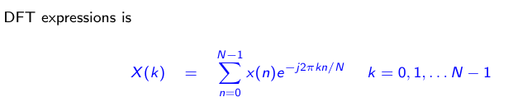

Applications of DFT: Spectral analysis, Convolution of signals, Data compression etc

Slide 6
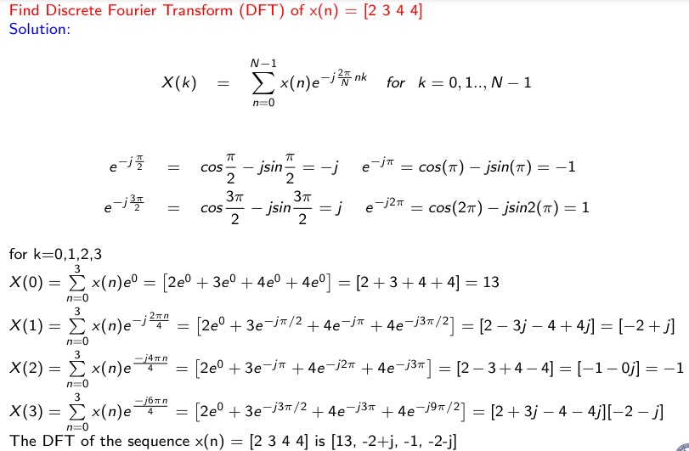

Slide 7
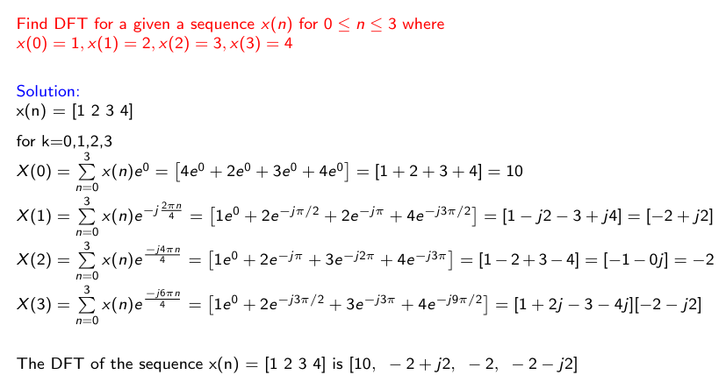

Slide 8
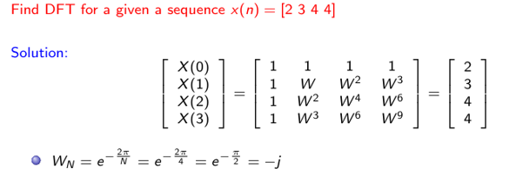
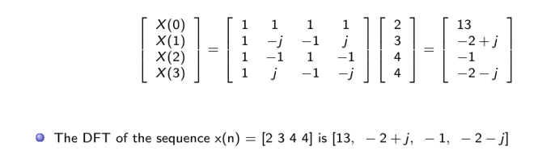

Slide 9
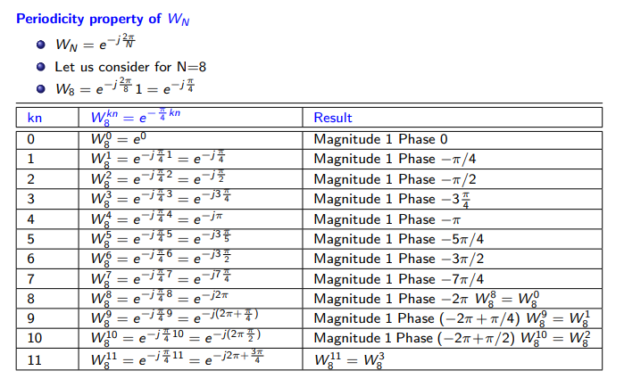

Slide 10
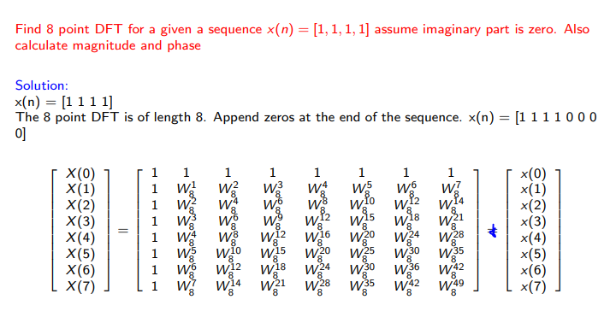

Slide 11
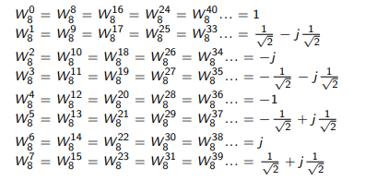

Slide 12
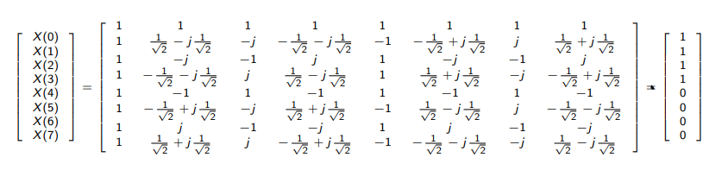

Slide 13
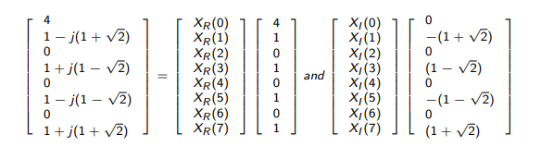

Slide 14
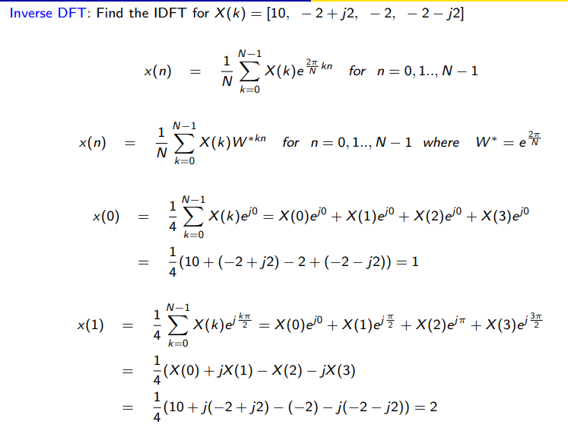

Slide 15
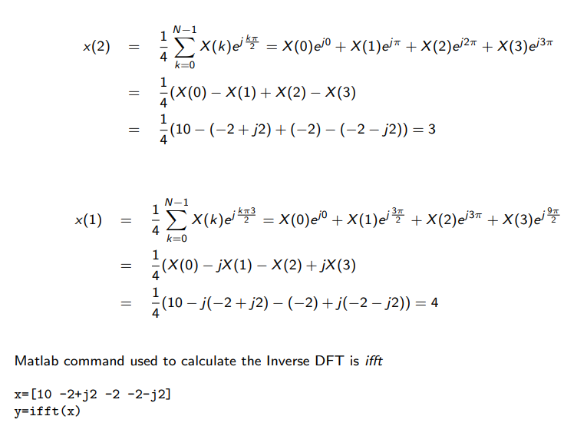

Slide 16
